Slide 1
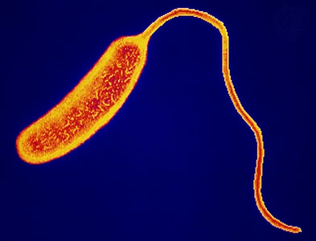
The influence of low pH on Vibrio tubiashii gene expression
Elene Dorfmeier
FISH 441 | December 9, 2009

Slide 2
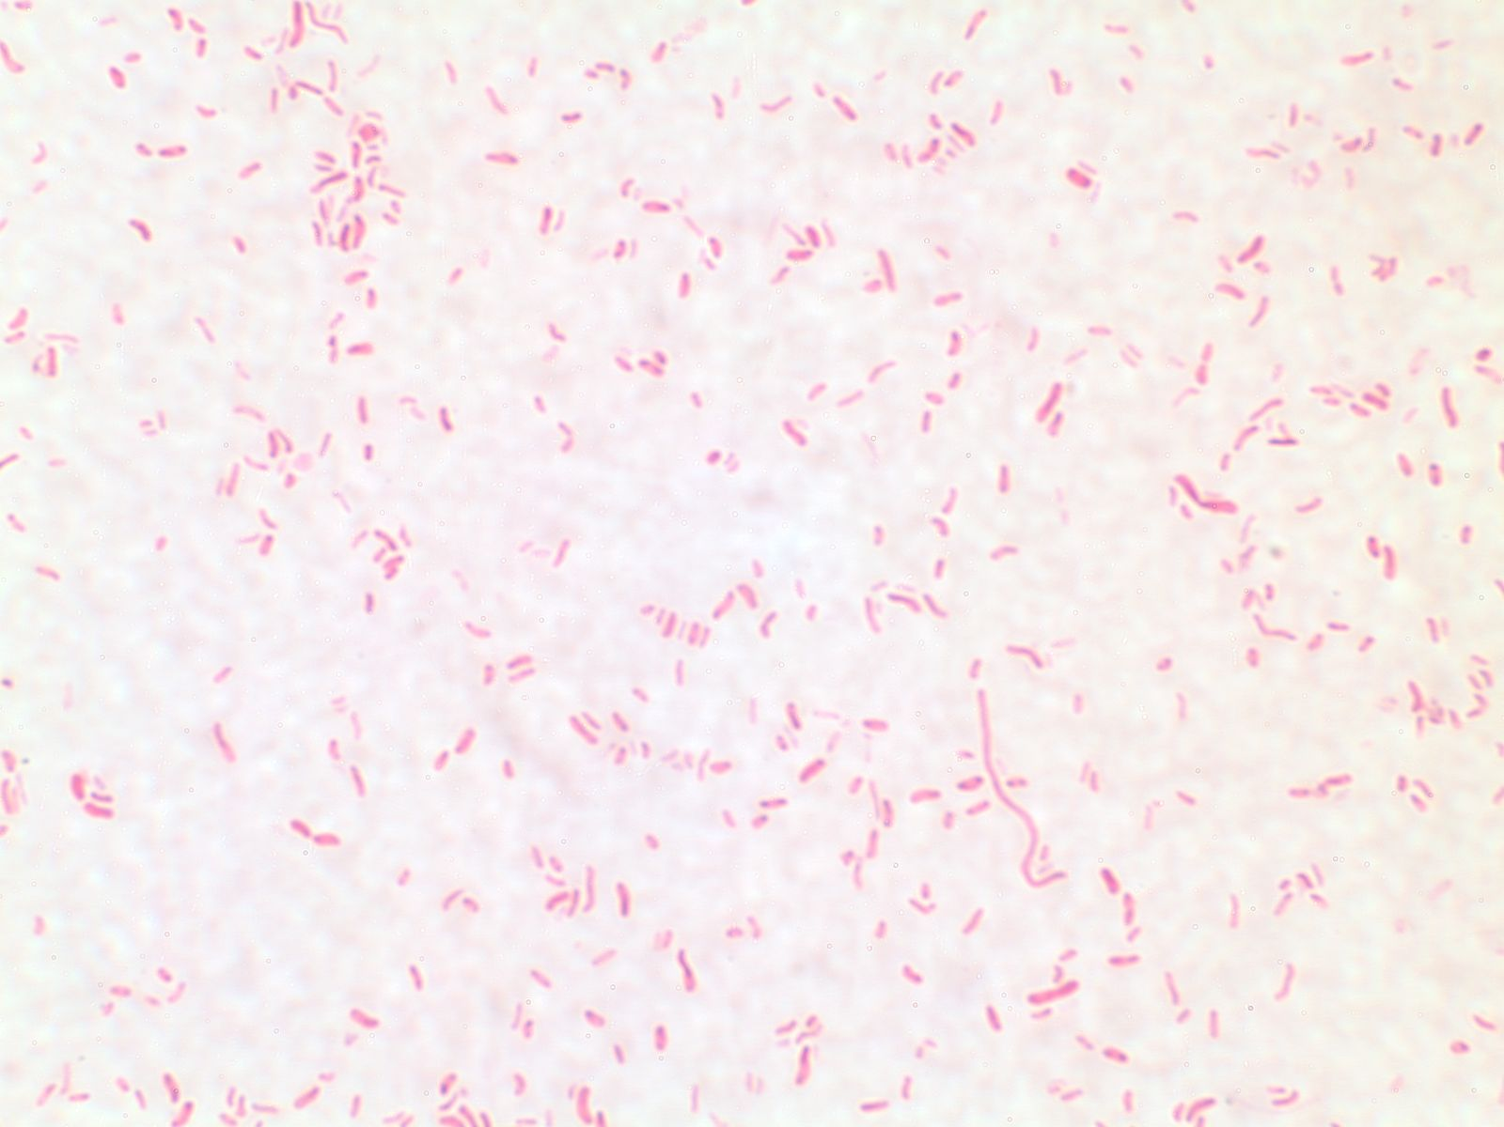
Vibrio tubiashii
Marine bacterium
Produces a disease called vibriosis
Pathogenic to a variety of marine invertebrates

Slide 3
How does low marine pH affect Vibrio tubiashii gene expression?

Slide 4
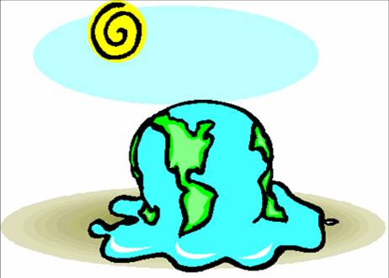
Why low pH?
Ocean acidification
Disease
Impact on local aquaculture
What influences proliferation?

Slide 5
V. tubiashii Genes of Interest
Alternative Sigma Factor E
Chitinase
L-threonine 3-dehydrogenase

Slide 6
V. tubiashii Genes of Interest
Alternative σ Factor E
rseA / rpoE
Regulates few genes
Associated with gene expression of virulence
Bacterial survival and virulence → go hand in hand

Slide 7
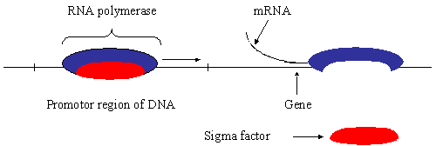
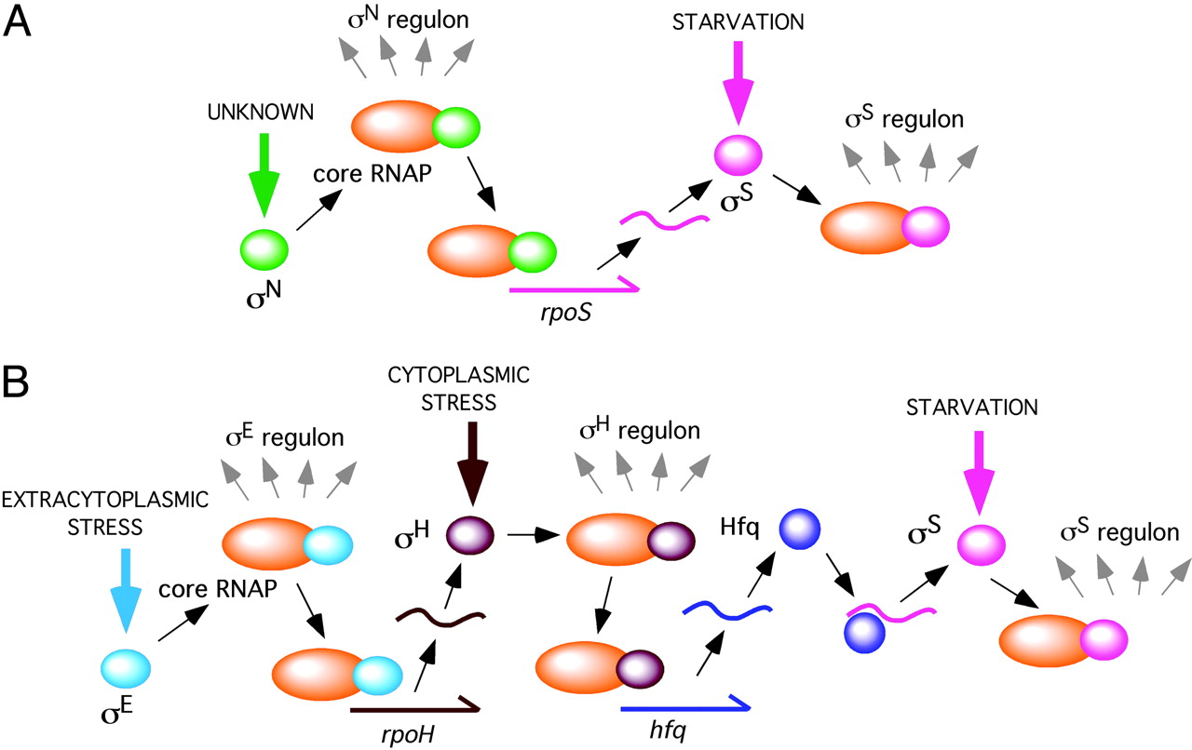
Fang F C PNAS 2005;102:4933-4934
http://faculty.clintoncc.suny.edu/faculty/Michael.Gregory/files/bio%20101/Bio%20101%20Lectures/Gene%20Regulation/gene.h9.gif
©2005 by National Academy of Sciences

Slide 8
V. tubiashii Genes of Interest
Chitinase (chiA)
Enzyme used to break down chitin
May have ecological role
L-threonine 3-dehydrogenase (tdh)
Virulence factor in Vibrio parahaemolyticus
Responsible for host cell damage

Slide 9
Experimental Design
CO₂ Monitor
7.3 pH
Control
Samples taken at 0, 24 and 48 hrs

Slide 10
RESULTS...

Slide 11
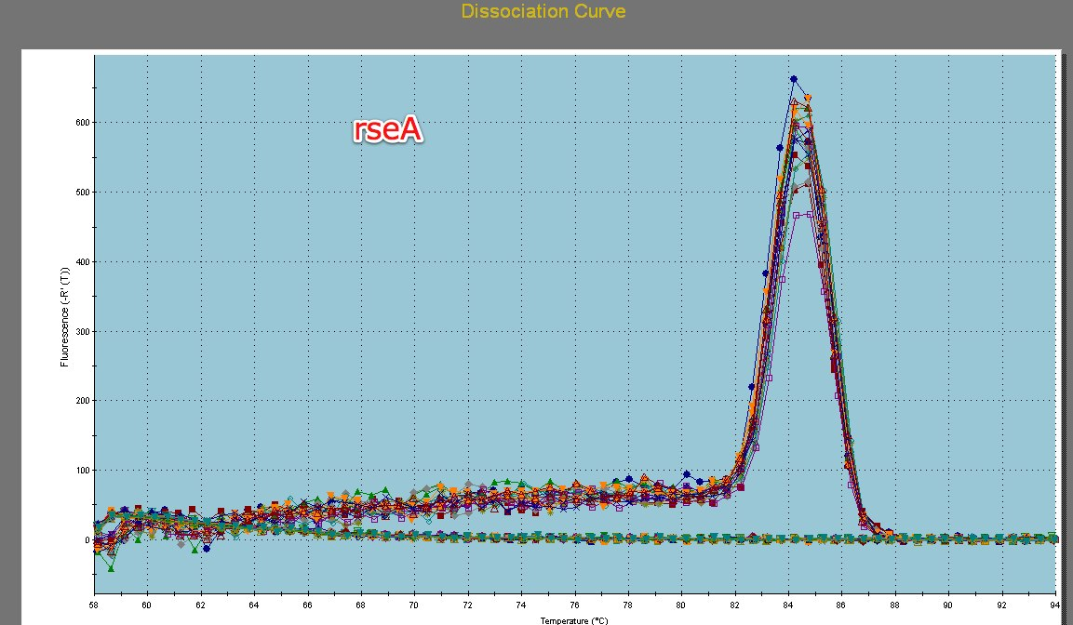

Slide 12
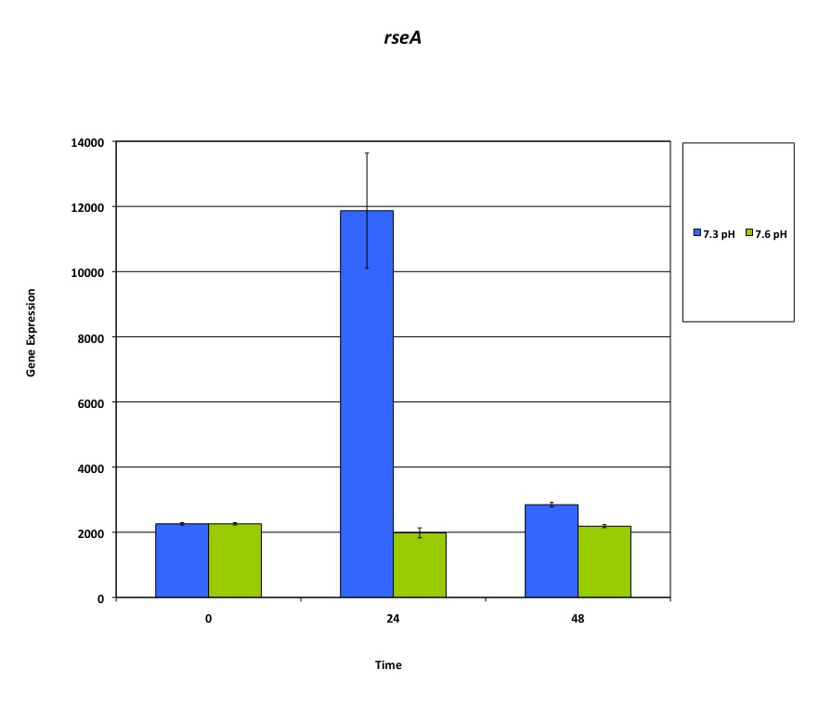
rseA

Slide 13
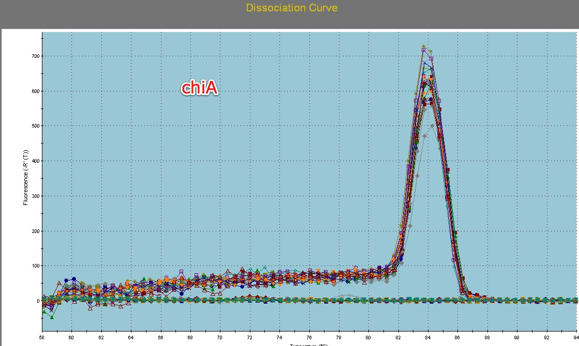

Slide 14
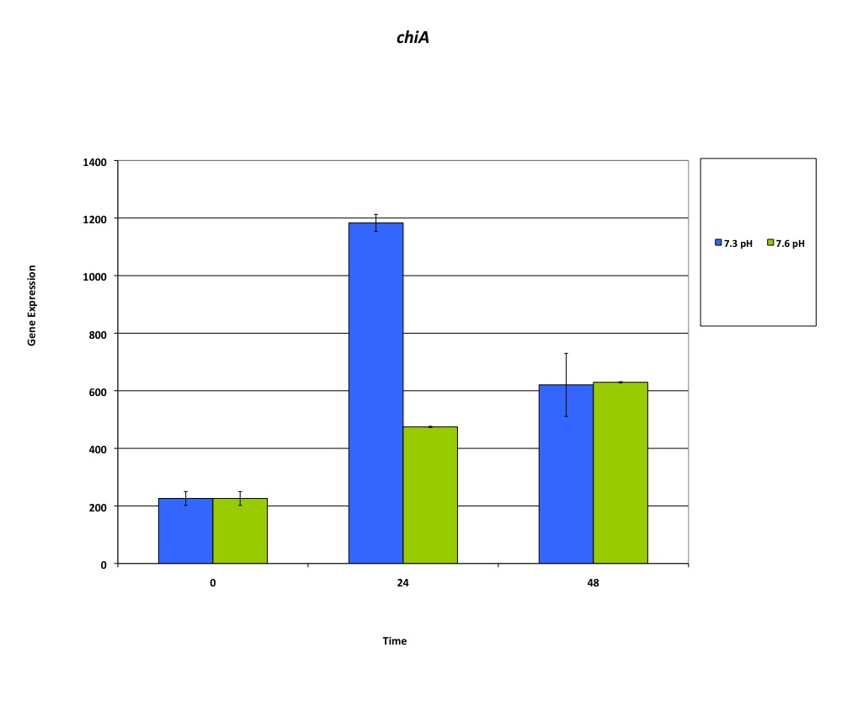
chiA

Slide 15
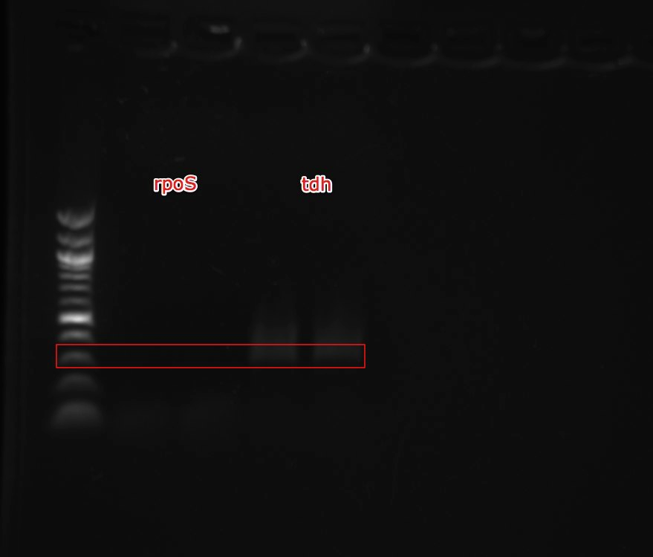
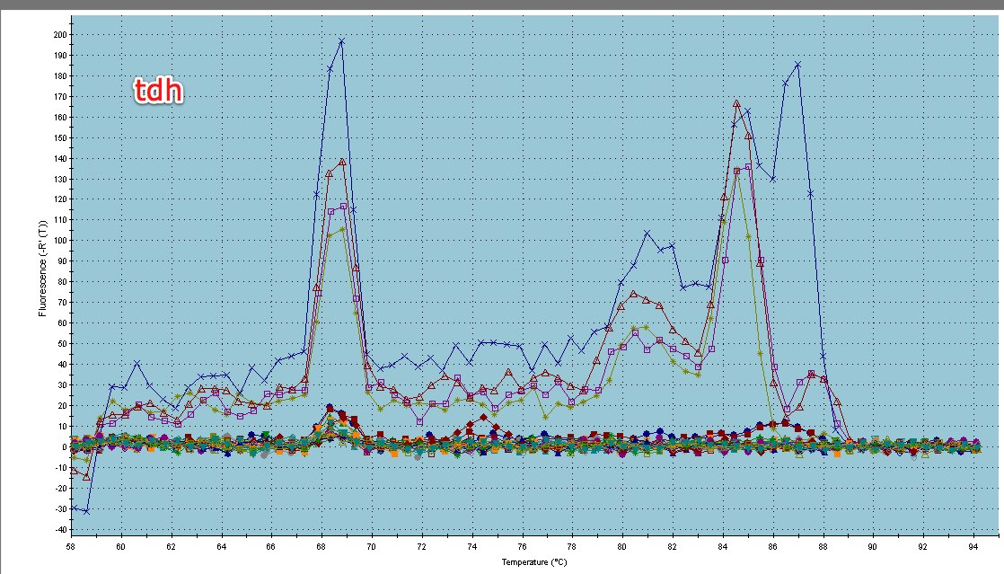

Slide 16
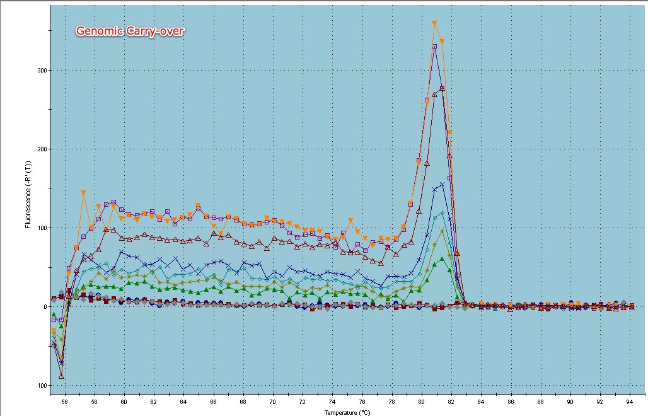
Problems
Genomic Carryover

Slide 17
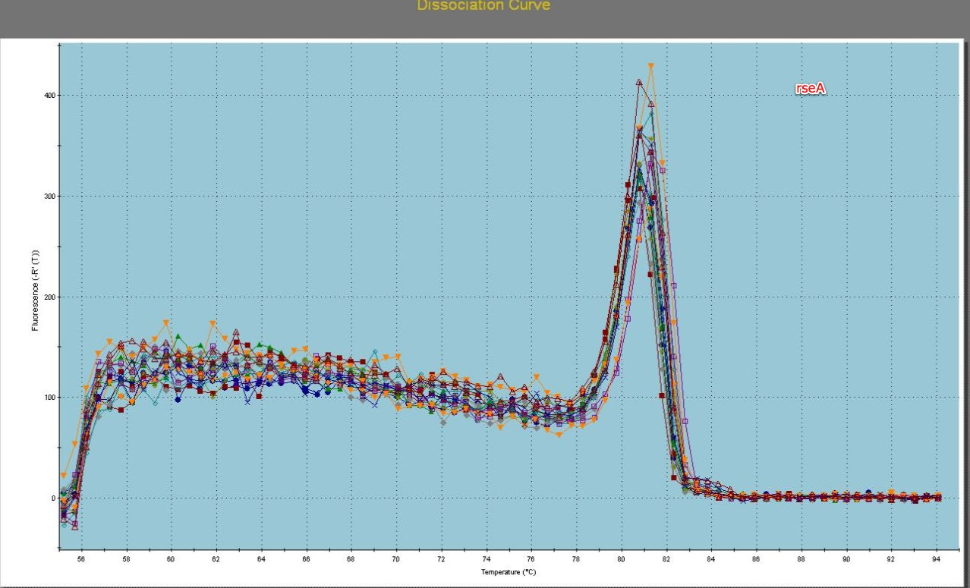
SYBR Better?
SYBR
Syto-13

Slide 18
Conclusions
rseA expressed at low pH
chiA expressed at both pH levels
Both genes expressed most at 24 hours
tdh not expressed in this study but may be applicable in future

Slide 19
Questions?

